Slide 1





The EarthFinders - SDG In Classroom
The EarthFinder
We are The EarthFinders, a team of passionate individuals dedicated to making education about sustainability accessible and engaging."
"Our mission is to bring the 17 Sustainable Development Goals (SDGs) into the classroom in a fun and interactive way."
"For this challenge, 'SDGs in the Classroom,' we utilized our skills in technology and education to create an impactful solution

Slide 2

















Understanding the SDGs
The 17 Sustainable Development Goals (SDGs) set by the United Nations address global challenges like poverty, inequality, climate change, and more."
"Our focus in this project is to make students aware of these goals and help them understand their significance."
"By integrating the SDGs into the educational curriculum, we empower the next generation to take action and work towards a sustainable future."

Slide 3
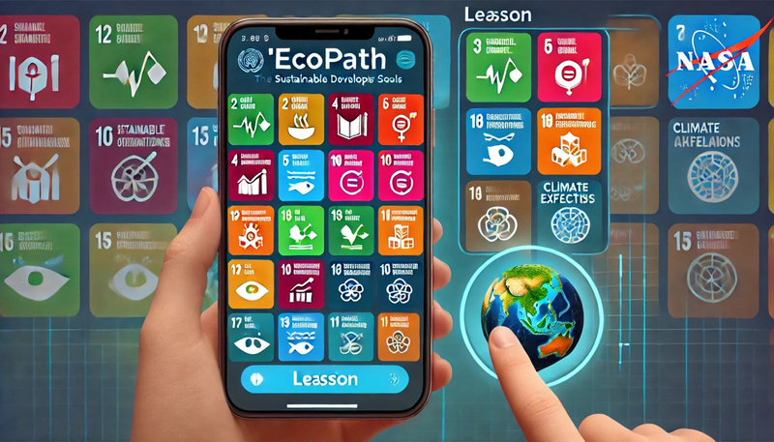
Our Solution
EcoPath is an interactive educational app that brings the SDGs to life for students."
"Through immersive multimedia content, quizzes, Augmented Reality (AR) experiences, and AI-powered tools, students can explore sustainability topics in a fun and meaningful way
It makes learning about sustainability engaging and accessible."
"Encourages critical thinking and active participation."
"Empowers students to explore, learn, and act on global issues

Slide 4
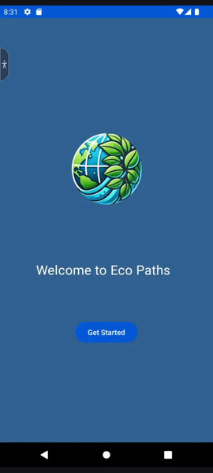
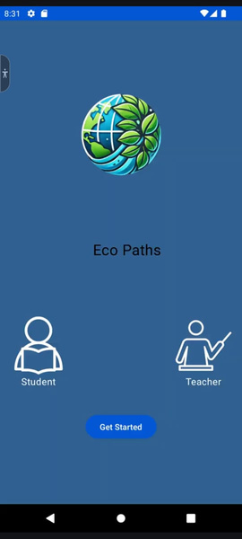
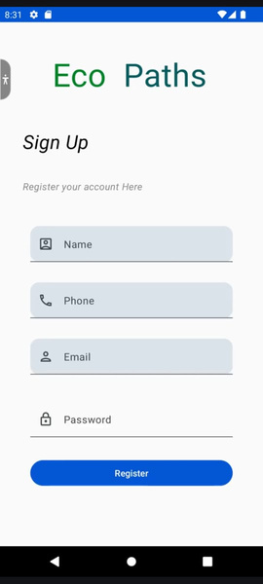
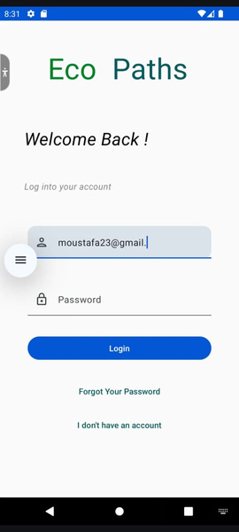
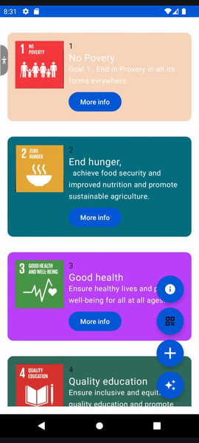
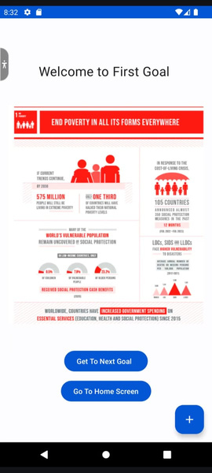
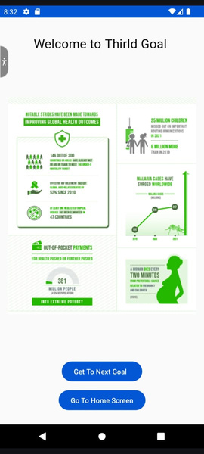

Inside the EcoPath App
Explore EcoPath's easy-to-navigate interface and engaging features."
"The app is designed to make learning about SDGs simple, interactive, and fun
Intro
Selecting
Sign UP
Sign In
Home
A Goal
A Goal
Intro

Slide 5


Interactive Features: QR and AR
Bringing Learning to Life with QR and AR
EcoPath takes learning beyond the textbook with its AR and QR code functionalities.
Students can scan QR codes to experience 3D AR models of global challenges, like melting glaciers or deforestation."
This feature provides an immersive way for students to visualize and interact with sustainability concepts, making learning more engaging and memorable

Slide 6
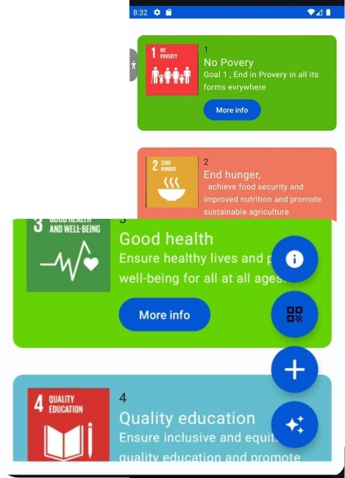
AI: Personalized and Dynamic Learning
EcoPath integrates an AI-powered search tool, enabling students to explore any SDG-related topic they are curious about.
The AI provides personalized, in-depth explanations, suggests additional resources, and simplifies complex concepts in real-time."
"By harnessing the power of AI, EcoPath makes learning more dynamic and tailored to each student's curiosity and pace

Slide 7

Impact and Success of EcoPath
EcoPath has the potential to revolutionize sustainability education by making it more engaging, interactive, and accessible for students everywhere.
It empowers both students and teachers, facilitating a deeper understanding of global sustainability challenges.
By utilizing AR, AI, and real-time data, EcoPath creates an educational experience that not only informs but also inspires action.
Our project aims to leave a lasting impact by fostering a new generation of global citizens committed to achieving the SDGs

